Slide 1
CLOUDSECOPS MADE EASIER WITH OPEN SOURCE
Drive Security Automations and Help the Community

Slide 2
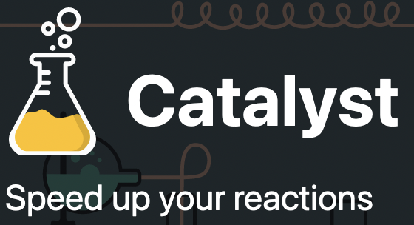





TOOLS WE USE
An actual analyst had quoted something like- “I’m just a monkey copying hashes from one window to another”

Slide 3
KNOTTY THREAT HUNTING
Tribal Knowledge sharing is difficult
Some processes always fall through cracks between the tooling
“I’m just a monkey copying hashes from one window to another”
Critical information gets lost in tool spraw

Slide 4
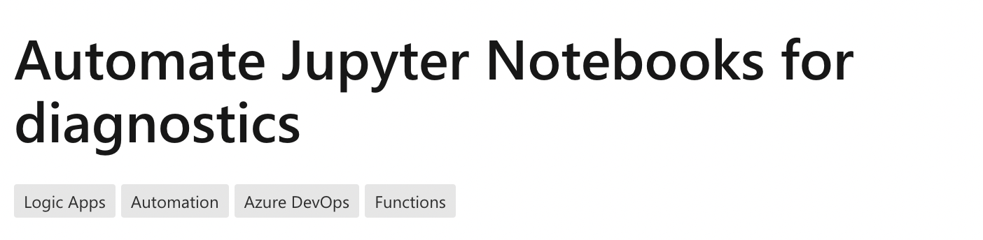


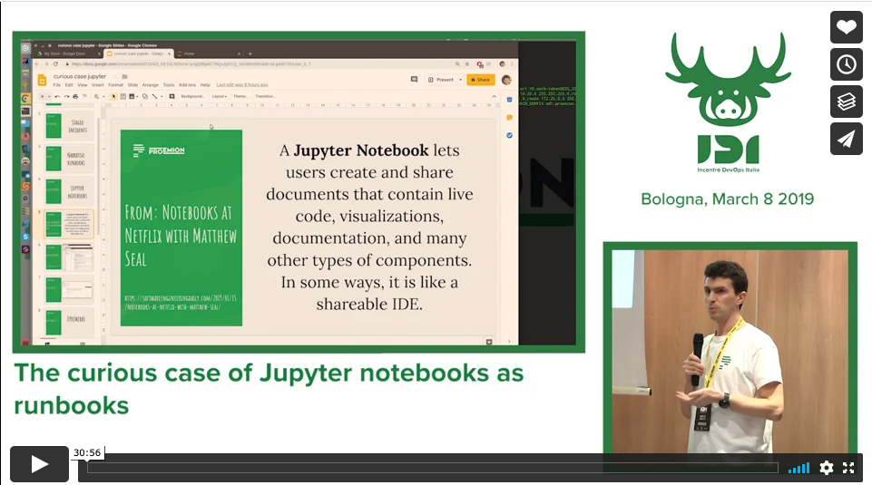
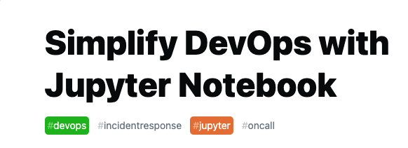
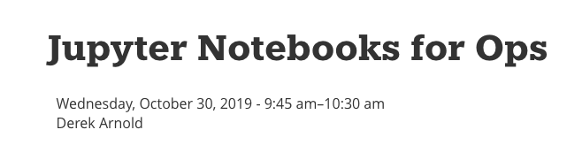

Slide 5
JUPYTER INTRO
Open-source web application
Around since 2014
Create and share documents
Live code
Visualizations
Markdown text
Interactive Run-time (Python et al)
Extensible with plugins

Slide 6


WHAT DOES IT LOOK LIKE IRL

Slide 7
SUMMARY
Better runbooks
Easy sharing and code reuse
Wealth of extensions for added functionality
Secure and free

Slide 8

ANTI-DREAD VACCINE
Try it out – easy to install!
Contribute to awesome-cloudops-automation on Github
Go to runbooks.sh or Scan this QR

